Slide 1
EConCard
Guide:
MS.ASHWANI VIJAYACHANDRAN
Assistant Professor KARTHIK PRASAD
Dept of Computer Applications Roll No: 31
S3 MCA

Slide 2
Table of content
Introduction
Abstract
Scope & Objective
Feasibility Study
Problem Definition
Existing System
Literature Review
System Requirements
Modules of Proposed System
Diagrams
System Architecture
Demo video
Ressult Analysis
Future scope
Conclusion
Reference

Slide 3
Introduction
The Electric Concession Card Generating Web Application enables students to generate and download concession cards independently.
Eliminates the need for intervention from schools, colleges, or public authorities.
Designed with a user-friendly interface for ease of use.
Provides a quick and efficient method to access and manage concession cards.
Streamlines the entire process, ensuring greater convenience and self-sufficiency for students

Slide 4
abstract
A digital platform that automates student concession card applications.
Replaces manual paperwork with a secure online process.
Students can register, apply, and download approved cards instantly.
Enables quick verification by administrators and transport officers.
Reduces delays, errors, and paper usage, improving efficiency.
Makes the entire process faster, transparent, and eco-friendly.

Slide 5
Scope & objective

Slide 6
Scope
Student concession card generation
No institutional approval required
Accessible online
Simple and fast process

Slide 7
objective
Build a user-friendly web app
Enable self-service for students
Save time and effort
Improve accessibility

Slide 8
FEASIBILITY STUDY

Slide 9
Economic Feasibility
1. Cost Savings: Automating the concession card application process can reduce administrative costs.
2. Reduced Paperwork: Digital documentation can minimize paper and storage costs.
3. Increased Efficiency: Streamlined process can lead to increased productivity.

Slide 10
Technical Feasibility
1. Web Development Framework: Django or Flask can be used to build the system.
2. Database: Relational databases (e.g., MySQL, PostgreSQL) or NoSQL databases (e.g., MongoDB) can store student data and application information.
3. Security: Implementing robust security measures (e.g., encryption, secure authentication) can protect student data.

Slide 11
Social Feasibility
1. Student Benefits: The system can provide a convenient and efficient way for students to apply for concession cards.
2. Institutional Benefits: The system can enhance the institution's reputation by providing a modern and efficient service.
3. Environmental Benefits: Digital documentation can reduce paper usage.

Slide 12
Operational Feasibility
1. User Adoption: A user-friendly interface can facilitate adoption by students and admin staff.
2. Training: Minimal training may be required for admin staff to effectively utilize the system.
3. Support: Ongoing support and maintenance can ensure the system's continued functionality.

Slide 13
Existing system
Offline Form Submission
Manual Verification
Delayed Processing
Lack of Transparency
Repetitive Procedures

Slide 14
proposed system
Online Application
Digital Document Upload
Automated Verification
Instant Card Generation
Status Tracking
Secure

Slide 15
Literature Review
Author | Year | Source | Title | Work Done By Key Features
Sharma, A. & Verma, R. A Web-Based ID Card Generation System | 2020 | International Journal of CSIT | A Web-Based ID Card Generation System | Proposed a web app for student ID generation with auto-fill forms and admin validation features
Kumar, N. & Sinha, P. | 2021 | IJERT | Automated College Document Generator | Developed a platform to create and manage digital student documents like bonafide and ID cards..

Slide 16
Literature Review
Author | Year | Source | Title | Work Done By Key Features
Thomas, J. & Mathew, R. | 2022 | IEEE Xplore Conference | Digitization of Student Certification Services | Introduced QR-based verification and digital delivery of student-related certificates.
Banerjee, S. & Ghosh, M. | 2023 | Springer – SmartTech Journal | Automation of Administrative Workflows in Academic Institutions | Focused on digitizing routine academic tasks, including ID and concession card generation
Ahmed, F. & Khan, R. | 2024 | Elsevier – Education Tech Today | Secure Cloud-Based ID Card System for Students | Designed a secure cloud app to manage student ID card requests and enable online issuance.

Slide 17
SYSTEM REQUIREMENTS

Slide 18
Hardware requirements
Minimum (for basic development)
CPU: Intel i5 / AMD Ryzen 5 (8th Gen or above)
RAM: 8 GBStorage: 256 GB SSD
OS: Windows 10/11, macOS, or Ubuntu (based on preference)
Other: Stable internet, browser
(Chrome/Firefox), and a code editor (e.g., VS Code)

Slide 19
Software requirements
Operating System: Windows
Backend: Python (Django Framework)
Frontend: HTML, CSS, JavaScript
Database: MySQL / SQLiteWeb
Server: Apache / Nginx (or Django built-in server for testing)
Browser: Chrome / Edge / Firefox (latest versions)

Slide 20
Modules of proposed system
User (Student) Module
Students can register and log in securely.
Submit concession application with personal and college details.
Upload documents (ID, certificate, photo, etc.).

Slide 21
2. Admin Module
Verify student applications and uploaded documents.
Manage user accounts and system data.
Forward approved applications to the Transport Officer.
3. Transport Officer Module
Review and validate applications.
Generate and authorize digital concession cards.
Send approved cards for student download.
Maintain records and reports of issued cards.

Slide 22
Dataflow diagram(dfd)

Slide 23
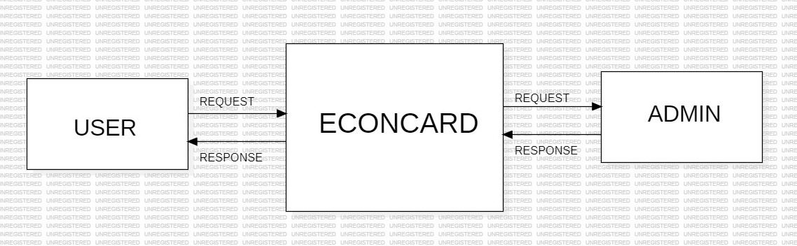
Level-0

Slide 24
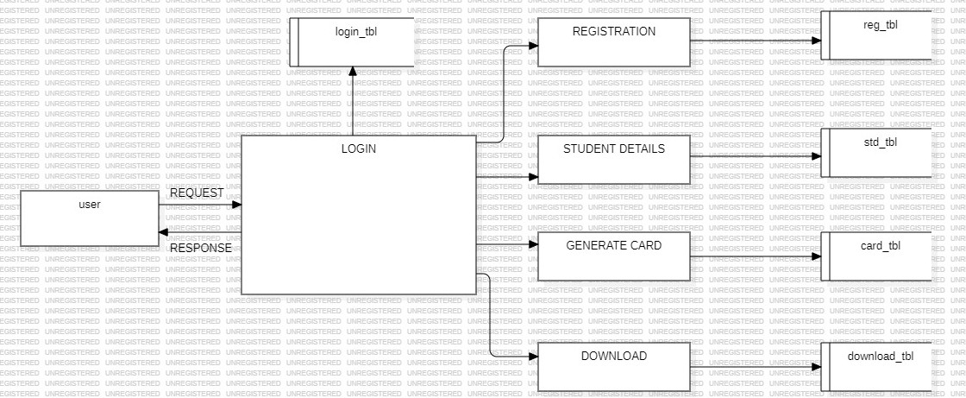
LEVEL-1

Slide 25
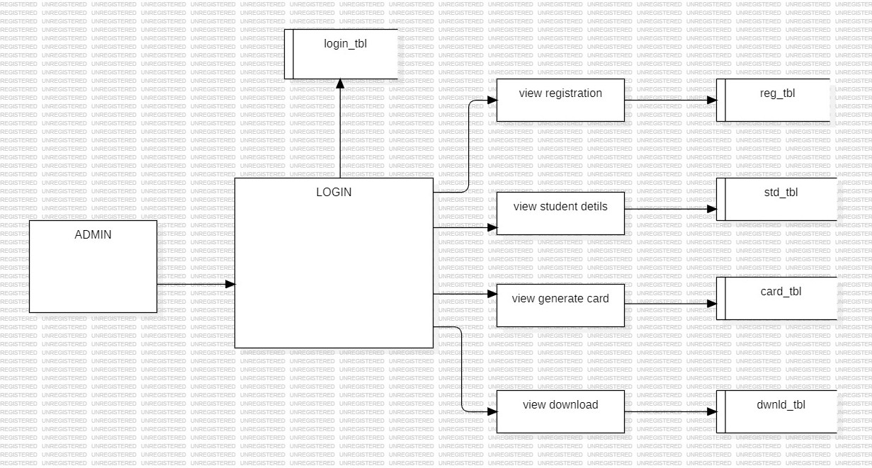
Level-2

Slide 26
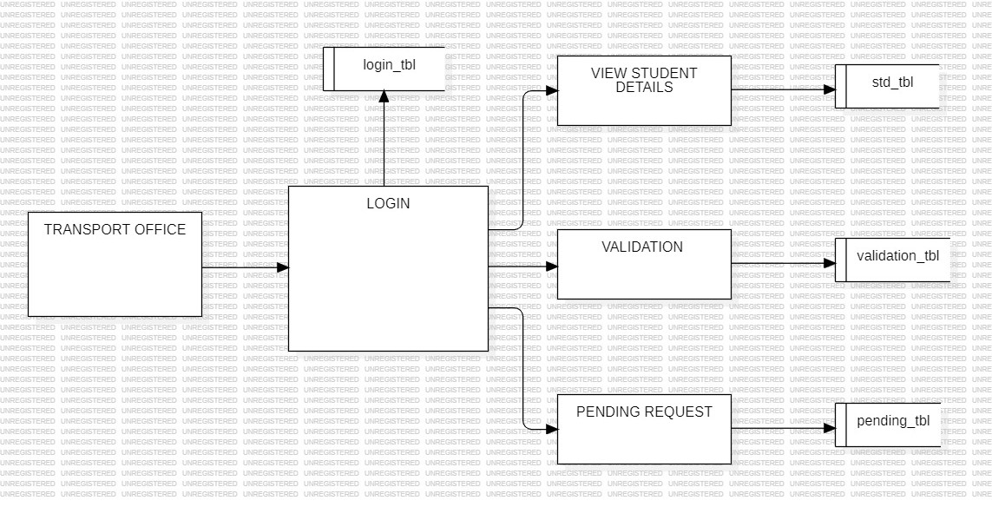
Level-3

Slide 27
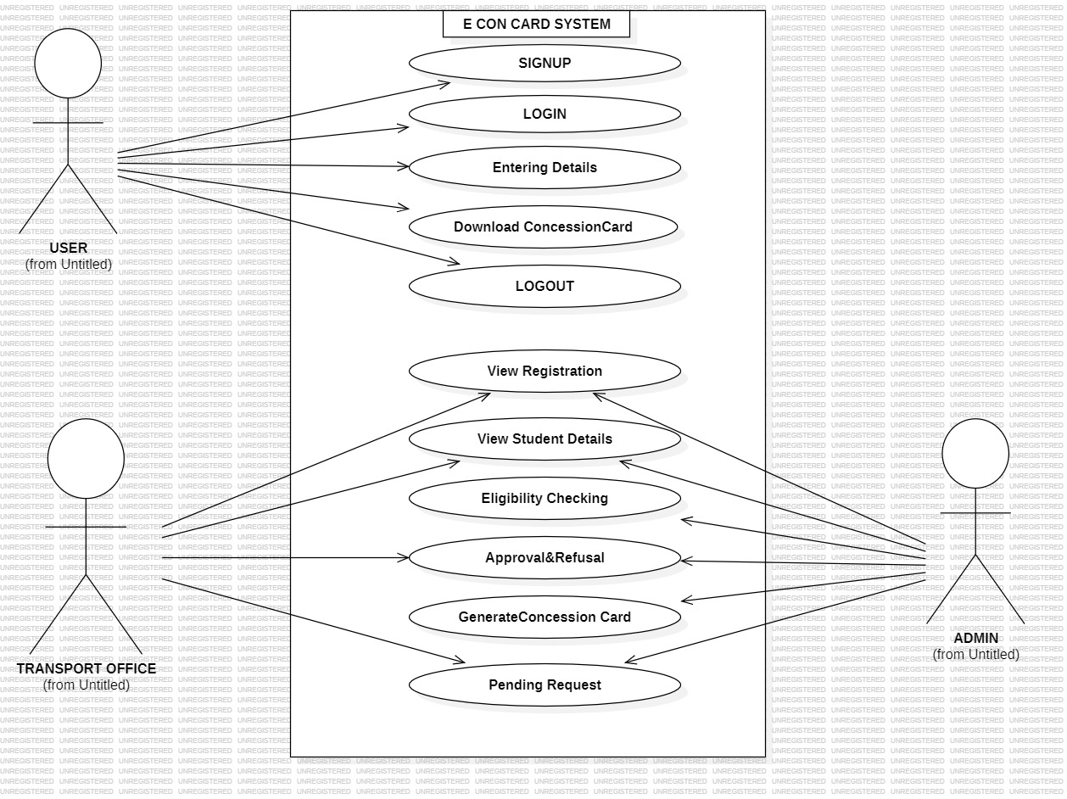
USE-CASE DIAGRAM

Slide 28
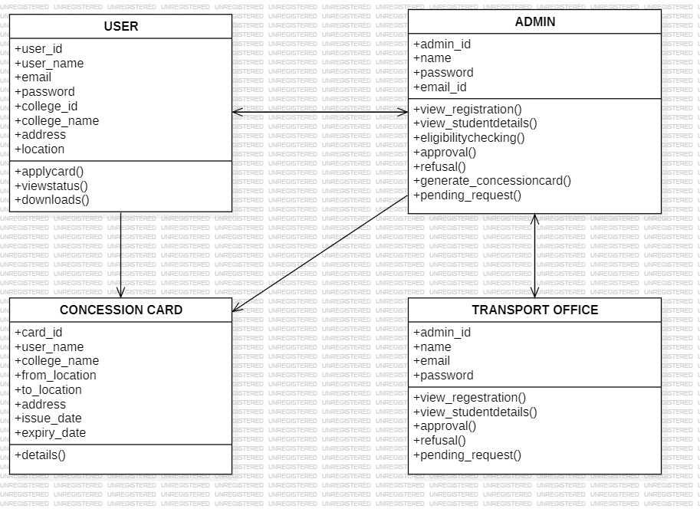
Class diagram

Slide 29
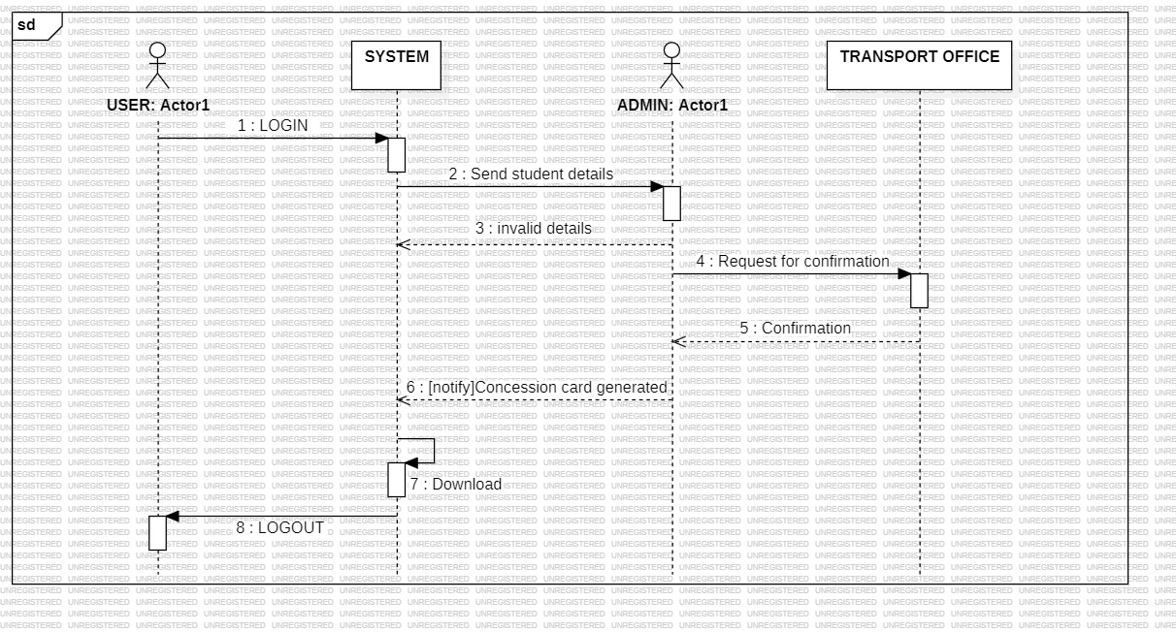
Sequence diagram

Slide 30
RESULT ANALYSIS
The Electric Concession Card Generating Web Application was successfully developed and tested on multiple user roles — Student, Admin, and Transport Officer.
The system performed accurately and efficiently, allowing students to register, apply, and download concession cards without errors.
Admin and Officer modules worked smoothly for verification and approval processes.
The web interface was found to be user-friendly, responsive, and secure.
Compared to the manual system, the new web application reduced processing time by over 70% and eliminated paperwork.
Overall, the project achieved all its objectives and proved to be a reliable and effective digital solution for managing student concession cards.

Slide 31
FUTURE SCOPE
A mobile app version can be developed for easier student access.
Add QR code–based digital cards for instant verification during travel.
Integrate with college databases for automatic student validation.
Enable email/SMS notifications for status updates and approvals.
Use AI and OCR technologies for automatic document verification.
Host the system on cloud servers for better scalability and performance.
Expand the application for multiple colleges or transport systems.

Slide 32
CONCLUSION
The system automates the student concession process, making it faster, paperless, and efficient.
Students can apply, verify, and download their concession cards easily online.
Developed using HTML, CSS, Java, and Django for a secure and reliable platform.
Ensures accuracy, data security, and user convenience.
Provides a smart digital solution that saves time and promotes technology-driven education services.

Slide 33
reference
[1] A. Singh, “Automation in educational administration: A case study,” International Journal of Computer Applications, vol. 175, no. 9, pp. 12–17, 2021. [2] R. Gupta, P. Joshi, and K. Patel, “Web-based automation for student services,” IEEE Access, vol. 8, pp. 10422–10431, 2020. [3] S. Sharma and M. Rao, “Online certification systems in higher education,” Proc. IEEE Int. Conf. Smart Systems, pp. 88–93, 2021. [4] V. Thomas, “Authentication mechanisms in educational web applications,” IEEE Trans. Educ. Technol., vol. 69, no. 4, pp. 340–346, 2020. [5] J. Li and H. Zhang, “Cloud-based frameworks for e-governance,” IEEE Cloud Comput., vol. 7, no. 2, pp. 56–63, 2021.

Slide 34
Thank you

